Slide 1
Different ways of writing the equation of a line
MJ O’Callaghan

Slide 2
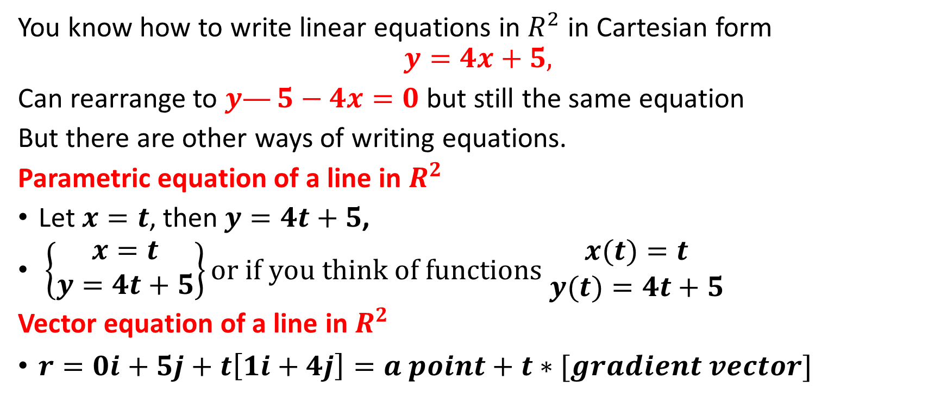

In the beginning there was only $x$ and $y$
You know how to write linear equations in $R^{2}$ in Cartesian form
$$y=4x+5,$$
Can rearrange to $y—5−4x=0$ but still the same equation
But there are other ways of writing equations.
Parametric equation of a line in $R^{2}$
Let $x=t$, then$y=4t+5$,
$\left\{\begin{matrix}x=t \\ y=4t+5\end{matrix}\right\}or if you think of functions \begin{matrix}x(t)=t \\ y(t)=4t+5\end{matrix}$
Vector equation of a line in $R^{2}$
$r=0i+5j+t\left[1i+4j\right]=a point+t∗[gradient vector]$

Slide 3
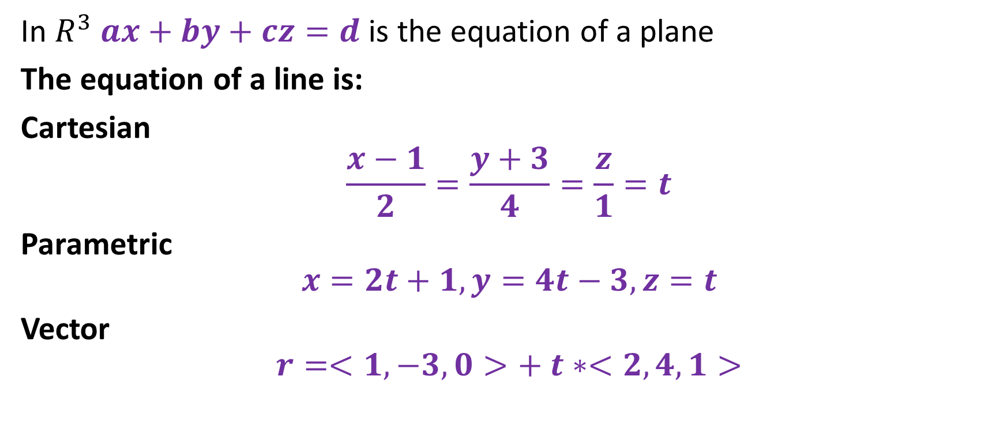

In $R^{3}$
In $R^{3}$ $ax+by+cz=d$ is the equation of a plane
The equation of a line is:
Cartesian
$$\frac{x−1}{2}=\frac{y+3}{4}=\frac{z}{1}=t$$
Parametric
$$x=2t+1,y=4t−3,z=t$$
Vector
$$r=<1,−3,0>+ t∗<2,4,1>$$

Slide 4
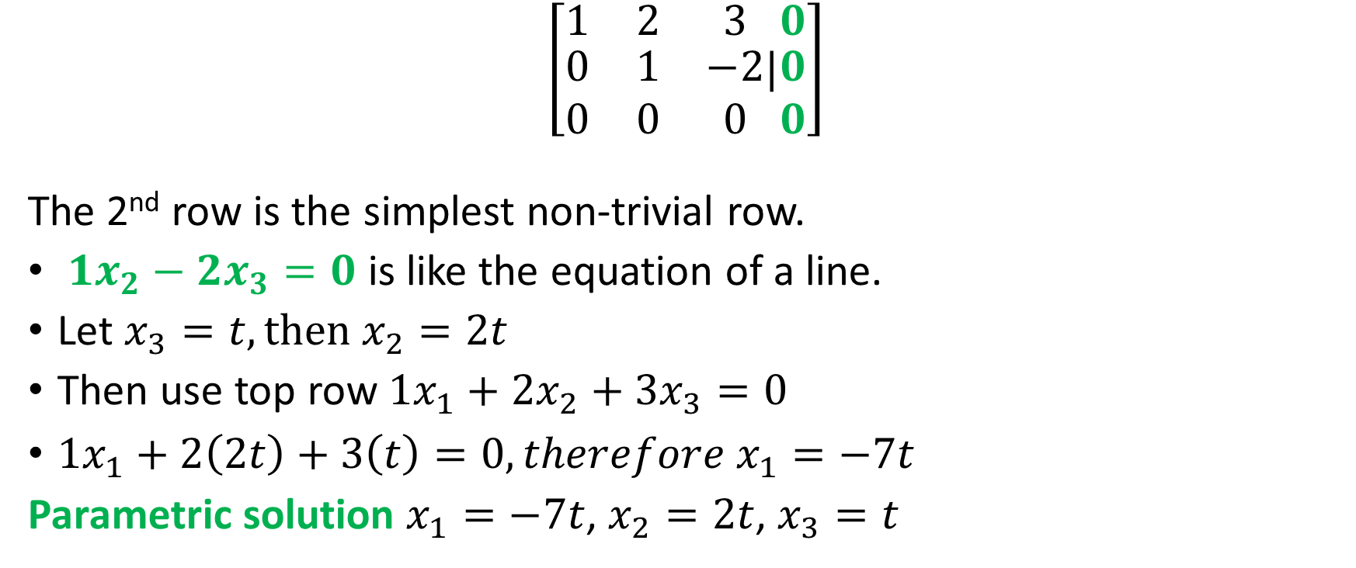

Homogeneous Linear System with $∞$ Solutions
$$\left[\begin{matrix}1 & 2 & 3 \\ \begin{matrix}0 \\ 0\end{matrix} & \begin{matrix}1 \\ 0\end{matrix} & \begin{matrix}−2 \\ 0\end{matrix}\end{matrix}|\begin{matrix}0 \\ \begin{matrix}0 \\ 0\end{matrix}\end{matrix}\right]$$
The 2nd row is the simplest non-trivial row.
$1x_{2}−2x_{3}=0$ is like the equation of a line.
Let $x_{3}=t, then x_{2}=2t$
Then use top row ${1x}_{1}+{2x}_{2}+{3x}_{3}=0$
${1x}_{1}+2\left(2t\right)+3\left(t\right)=0,therefore x_{1}=−7t$
Parametric solution $x_{1}=−7t$, $x_{2}=2t$, $x_{3}=t$

Slide 5
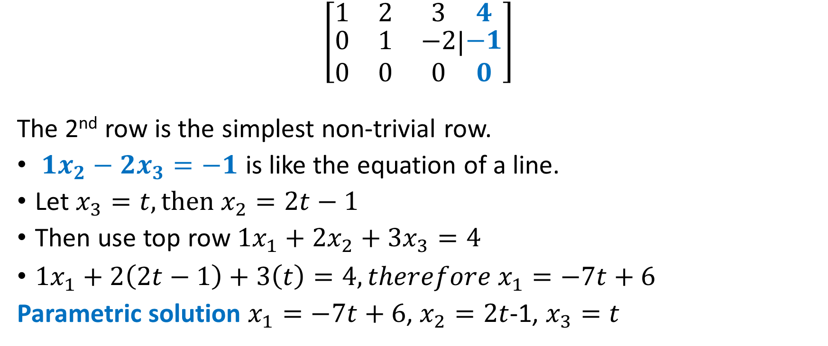

Linear system with $∞$ solutions – non homogeneous
$$\left[\begin{matrix}1 & 2 & 3 \\ \begin{matrix}0 \\ 0\end{matrix} & \begin{matrix}1 \\ 0\end{matrix} & \begin{matrix}−2 \\ 0\end{matrix}\end{matrix}|\begin{matrix}4 \\ \begin{matrix}−1 \\ 0\end{matrix}\end{matrix}\right]$$
The 2nd row is the simplest non-trivial row.
$1x_{2}−2x_{3}=−1$ is like the equation of a line.
Let $x_{3}=t, then x_{2}=2t−1$
Then use top row ${1x}_{1}+{2x}_{2}+{3x}_{3}=4$
${1x}_{1}+2\left(2t−1\right)+3\left(t\right)=4,therefore x_{1}=−7t+6$
Parametric solution $x_{1}=−7t+6$, $x_{2}=2t$-1, $x_{3}=t$

